Slide 1
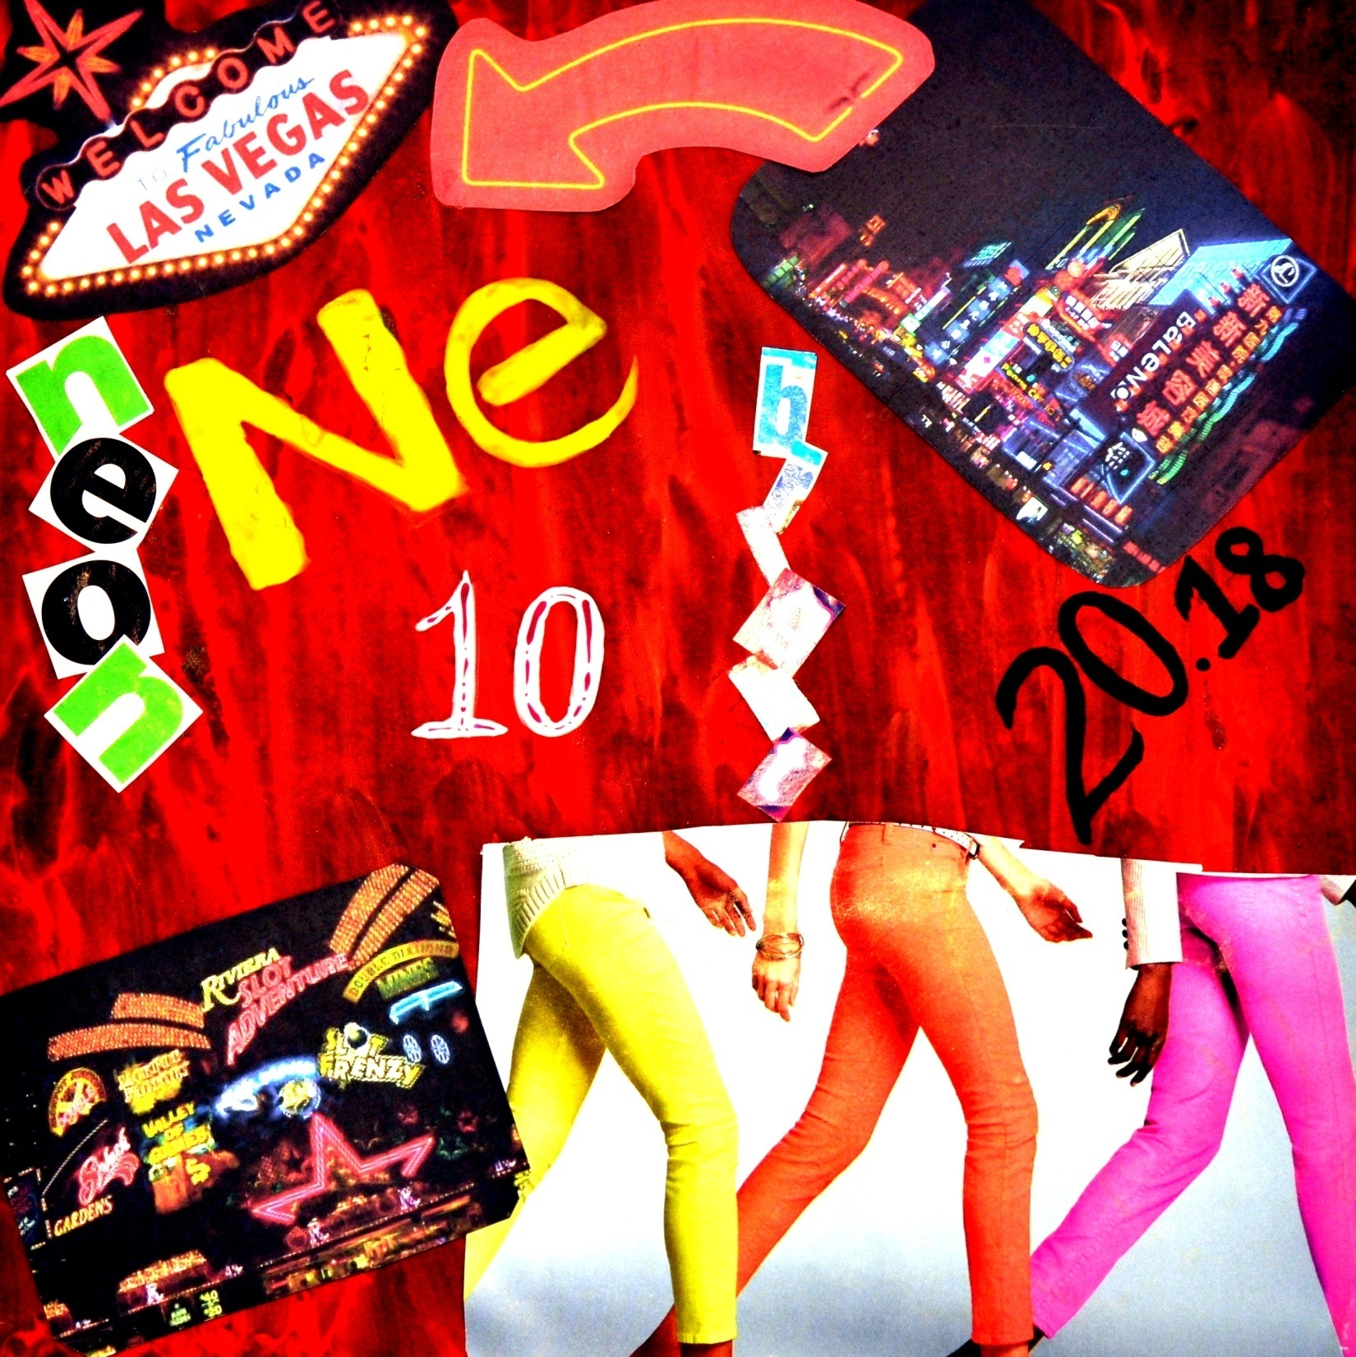
She's always buzzing just like Neon, neon Neon, neon Who knows how long, how long, how long She can go before she burns away, away. (John Mayer)
Neon was discovered in 1898 in London by Sir William Ramsay . It is an non-reactive, odorless, colorless gas at room temperature and most commonly used in advertising. Artisans fill flexible tubes with neon and can bend them to create words. The gas emits a pink glow when the tube is charged with electricity.

